Slide 1
Customize, CSS & Deploying Apps
Class 6

Slide 2
Agenda
Homework 2 Review
Project 1
Customize
DT Extras
Themes
Intro to CSS
Deploying to shinyapps.io

Slide 3
Homework 2

Slide 4
Homework 2
Mean | 93.07
Median | 95.4
StdDev | 7.54

Slide 5
Future Tips
Look at your parentheses
Be careful with unfinished pipes
Any files you need for your app should be in the app’s parent directory
Test everything in your UI before you think you’re done, every conceivable selection.
Some may not work the way you expect

Slide 6
Project 1

Slide 7
Project 1: Due SUNDAY (Sept 23rd) at NOON
Creating multiple types of visuals from the same data is an important way to convey information to application users. Students will create a Dashboard using a static download of an Open Data or a Dataset from their own place of employment (make sure you have permission to use it for this assignment first!)
Students may make their application in either flexdashboard or shinydashboard layouts and deployed onto shinyapps.io.
Directions: It must include at least three (4) filters, three (3) single numeric based boxes/gauges, one (1) datatable, and three (3) interactive and responsive charts. These elements should be places throughout a dashboard with at least three (3) pages with an analytical themes or question about the data. On the server side your plots and tables must utilize the reactive function for any and all datasets.
Your final app must work when deployed to shinyapps.io.

Slide 8
DT
https://rstudio.github.io/DT/

Slide 9



DT basic options
Hide rownames
Add a caption
Column filters
Hyperlinks

Slide 10
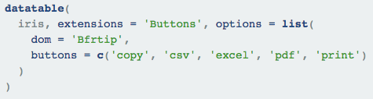
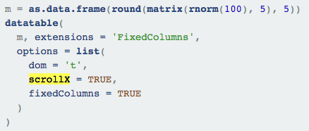
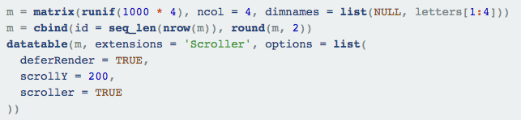
Extensions
Buttons
Fixed columns/scrolling
And much more!

Slide 11
Formatting
Currency/adding commas
Style a column/row/entire table

Slide 12
More layout stuff

Slide 13
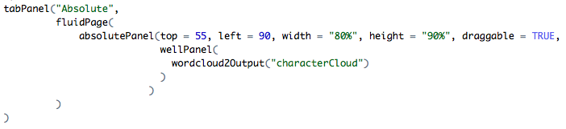
absolutePanel()
Creates an element that floats!
You should still put some kind of panel inside/ inputPanel, wellPanel or a series of rows/columns
This element will travel with whatever UI elements (divs) you have them inside.

Slide 14
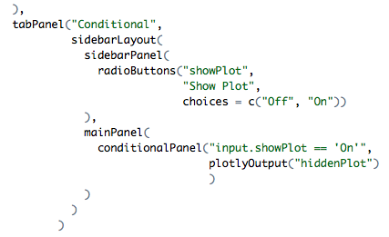
conditionalPanel()
Conditional panels automatically hide UI elements inside them until the condition described is met. (uses Js)
Another example: https://shiny.rstudio.com/gallery/conditionalpanel-demo.html

Slide 15
Themes!
And favicon

Slide 16

shinythemes package
State the theme in either the fuidPage(), navbarPage
Or let the user select the theme with a new input, themeSelector()!
You can also add your own custom css file (must be in a folder named www) by stating

Slide 17
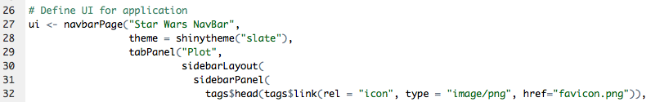
favicons
Just like custom css your favicon must be in the www folder
Then call it by name!

Slide 18
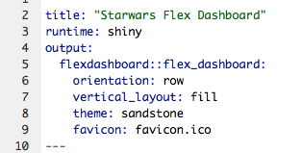
Favicons & themes in Flexdashboard

Slide 19
CSS

Slide 20
What is CSS?
Stands for: Cascading Style Sheet
It is a way of further augmenting your shiny elements.
There’s too much that can be done to count.
https://www.w3schools.com/css/

Slide 21
Targeting an element
Selector | Example | Example description
.class | .intro | Selects all elements with class="intro"
#id | #firstname | Selects the element with id="firstname"
* | * | Selects all elements
element | p | Selects all <p> elements
element,element | div, p | Selects all <div> elements and all <p> elements
Excerpt: https://www.w3schools.com/cssref/css_selectors.asp

Slide 22
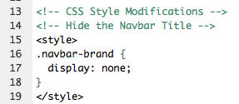
Using CSS in Shiny
You can either create a .css file, or add css arguments directly into your code.
Shiny App:
Flexdashboard:

Slide 23
How to do it yourself in the Chrome inspection tool
Directions:
Right click element
Select “Inspect”
Take div name from the right hand side
You can even edit the element in the “Styles” tab
Once you have things looking the way you want past the style element into your R code
Reload the app!

Slide 24
Shiny Apps.io
http://www.shinyapps.io/

Slide 25
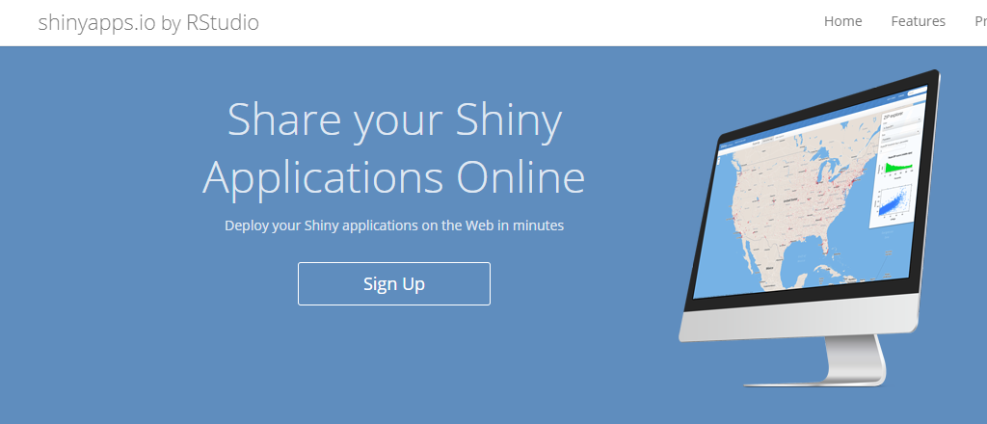
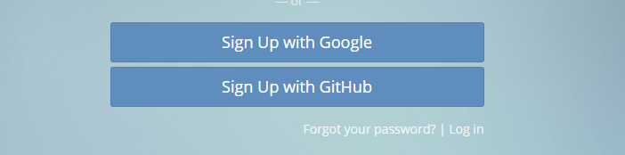
Register a free Account

Slide 26
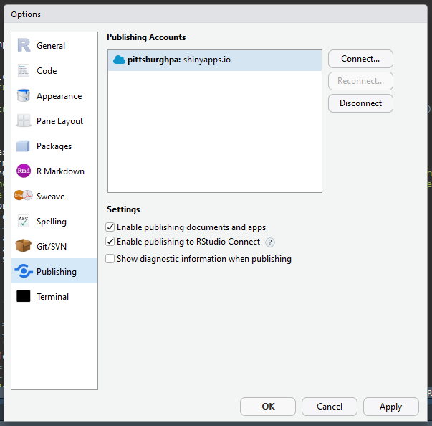
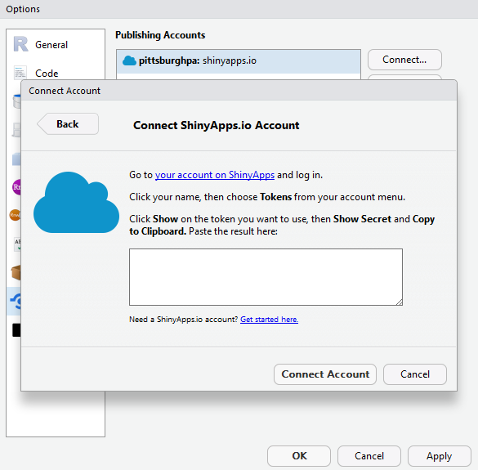
Connect your account

Slide 27
Before you publish!
re all the files your application needs in the folder with the app.R (or some other name) file(s)?

Slide 28

Publish one of your previous apps!

Slide 29
For Next Week
Reminder: next class is for help with Project 1

Slide 30
Please make sure you have the follow libraries installed
Map stuff:
rgdal
leaflet
leaflet.extras
Other stuff:
readxl
stringr

